Slide 1
Flash Cards
Submitted By:
RA1911003010872 - Suraj ARS
RA1911003010881 - YASH P SHAH

Slide 2
Abstract
A flashcard or flash card (also known as an index card) is a card bearing information on both sides, which is intended to be used as an aid in memorization.
Each flashcard bears a question on one side and an answer on the other. Flashcards are often used to memorize vocabulary, historical dates, formulas or any subject matter that can be learned via a question-and-answer format.
Flashcards can be virtual (part of a flashcard software), or physical.

Slide 3
Flashcards are an application of the testing effect − the finding that long-term memory is increased when some of the learning period is devoted to retrieving the information through testing with proper feedback.
Study habits affect the rate at which a flashcard-user learns, and proper spacing of flashcards has been proven to accelerate learning.
A number of spaced repetition software programs exist which take advantage of this principle.

Slide 4
Introduction
a card containing a small amount of information, held up for people to see, as an aid to learning.
A flashcard or flash card (also known as an index card) is a card bearing information on both sides, which is intended to be used as an aid in memorization. Each flashcard bears a question on one side and an answer on the other. Flashcards are often used to memorize vocabulary, historical dates, formulas or any subject matter that can be learned via a question-and-answer format. Flashcards can be virtual (part of a flashcard software), or physical

Slide 5
Use of Flash Card
Flashcards exercise the mental process of active recall: given a prompt (the question), one produces the answer. Beyond the content of cards, which are collected in decks, there is the question of use – how does one use the cards, in particular, how frequently does one review (more finely, how does one schedule review) and how does one react to errors, either complete failures to recall or mistakes? Various systems have been developed, mostly based around spaced repetition – increasing the time intervals between reviews whenever a card is recalled correctly.

Slide 6
Problem STATEMENT
A flashcard based learning tool is to be developed for use in the Real-Time Pro-graming This flashcard system will handle the creation, peer review and studying of student submitted flashcards.
The following tasks will be performed in order to create a maintainable, working
web application to realize the flashcard system.
Specify a list of functional and non-functional requirements for the system
Develop the client-server system, consisting of a single-page application and
a REST-API connected to a SQL database, satisfying the system requirements.
Test, deploy and host the system on a server
Beta test the system on students to test functionality, usability and scalability of the application.

Slide 7
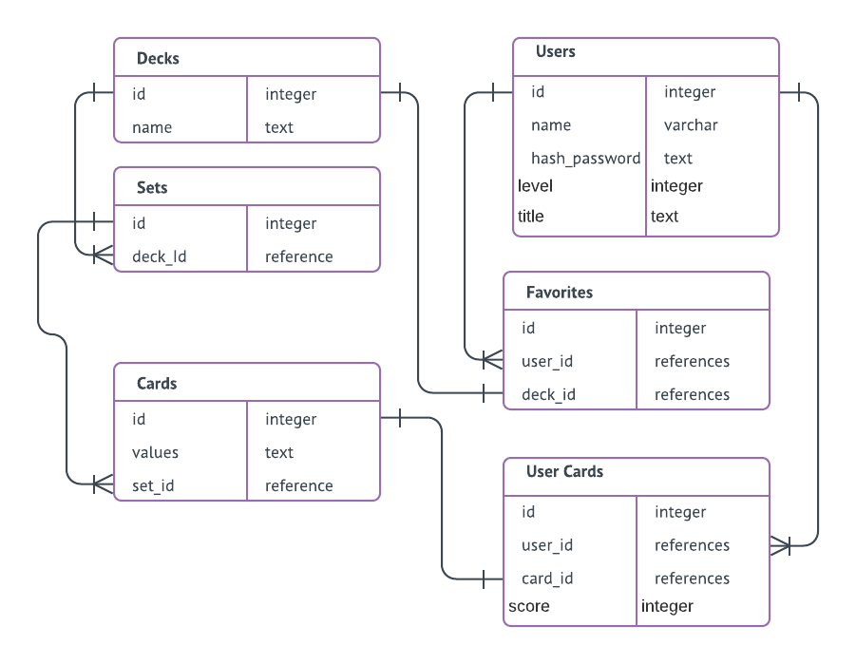
Er Diagram

Slide 8
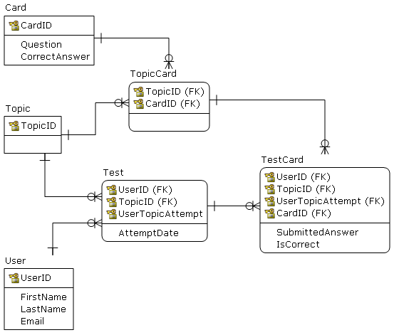
Schema Diagram

Slide 9
Modules
Adding deck : we can add the deck which we want.
Deleting deck : we can delete the deck which we don’t want.
Insomnia : it is a free cross-platform desktop application that takes the pain out of interacting with and designing HTTP-based APIs. Insomnia combines an easy-to-use interface with advanced functionality like authentication helpers, code generation, and environment variables.
Flash Decks is the easiest way to create, use and share flashcards online.
get started » Anyone, anywhere, anytime can learn using "spaced repetition" a proven learning technique. Start now, search for flashcards or browse deck subjects.

Slide 10
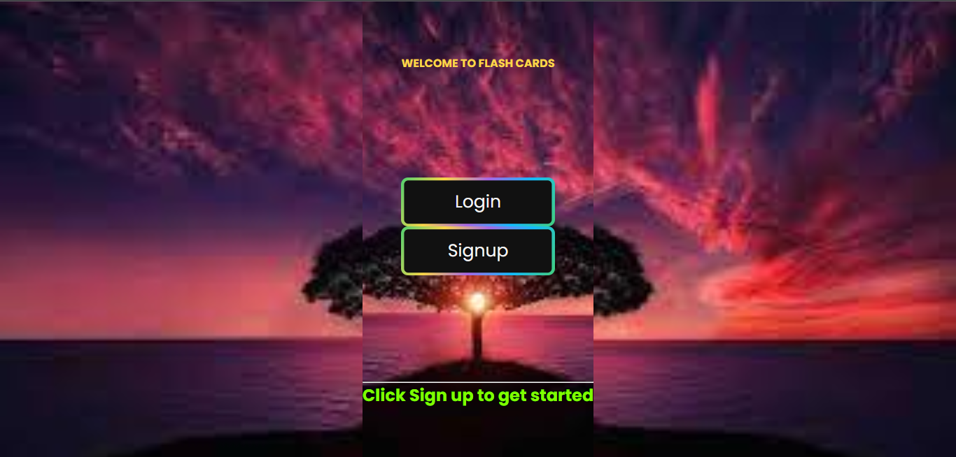
Admin page

Slide 11
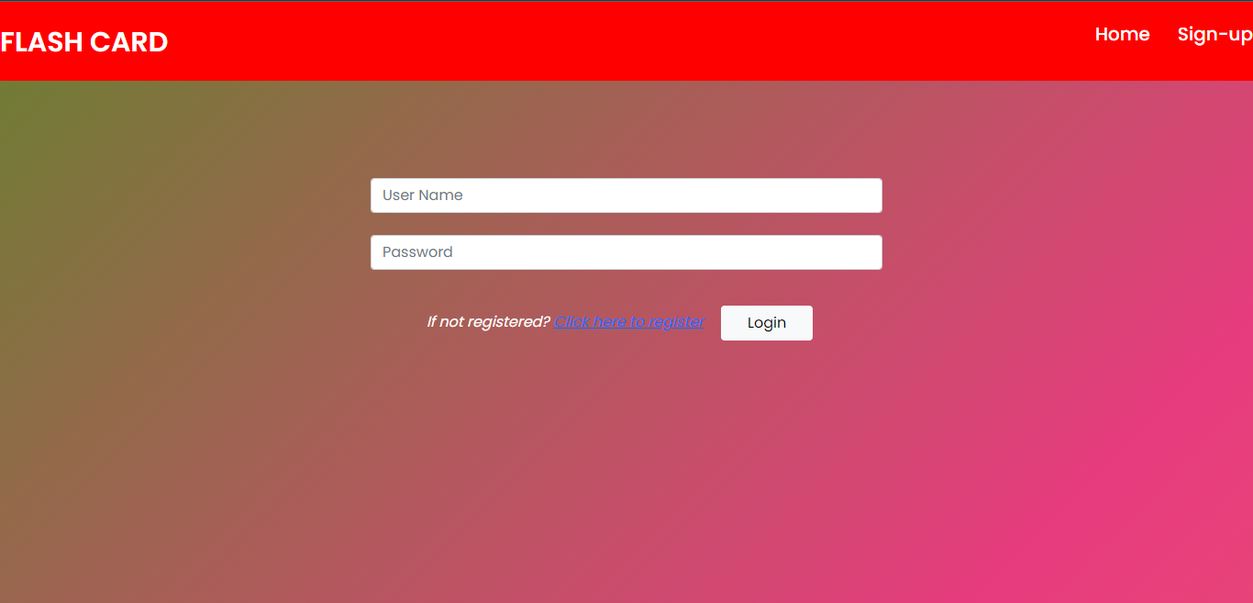
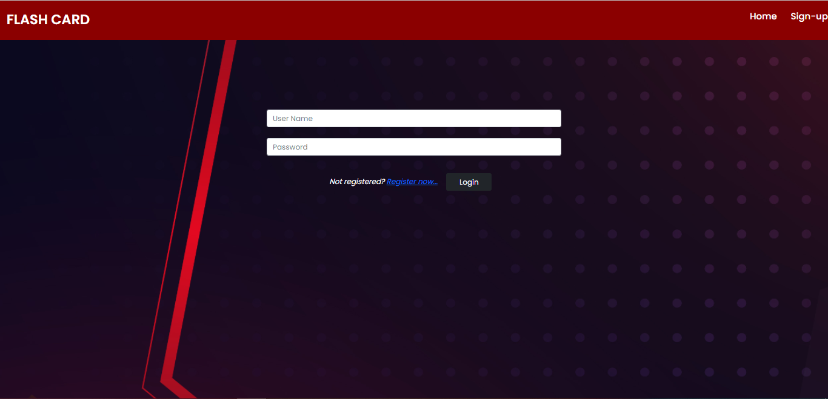
login

Slide 12
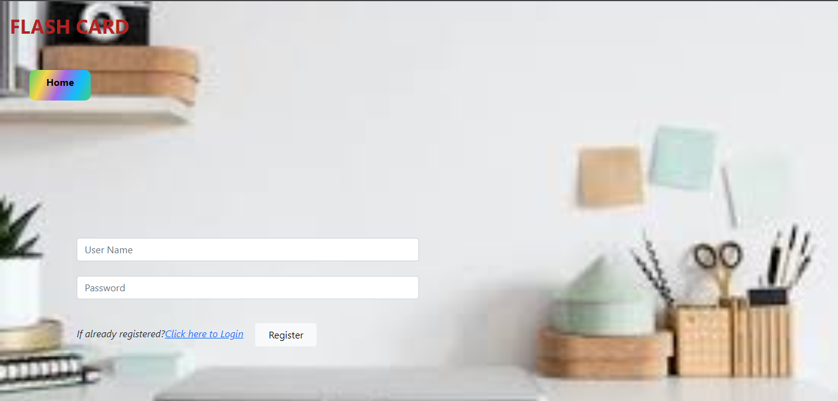
Signup

Slide 13
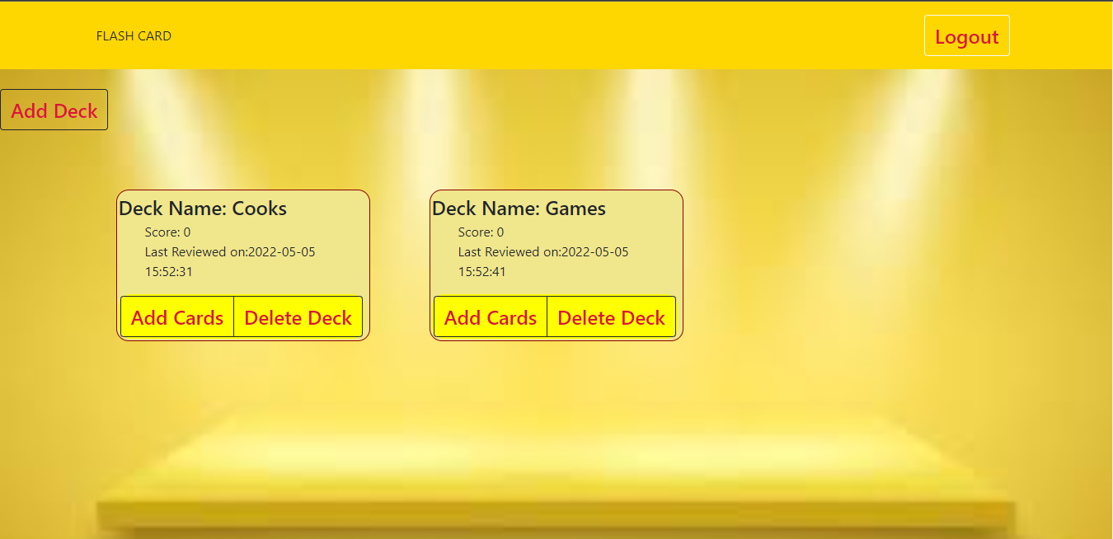
Home Page

Slide 14
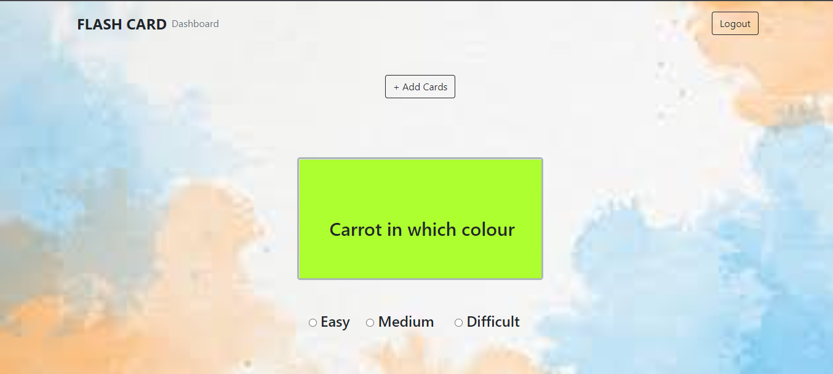
Add CARDS

Slide 15
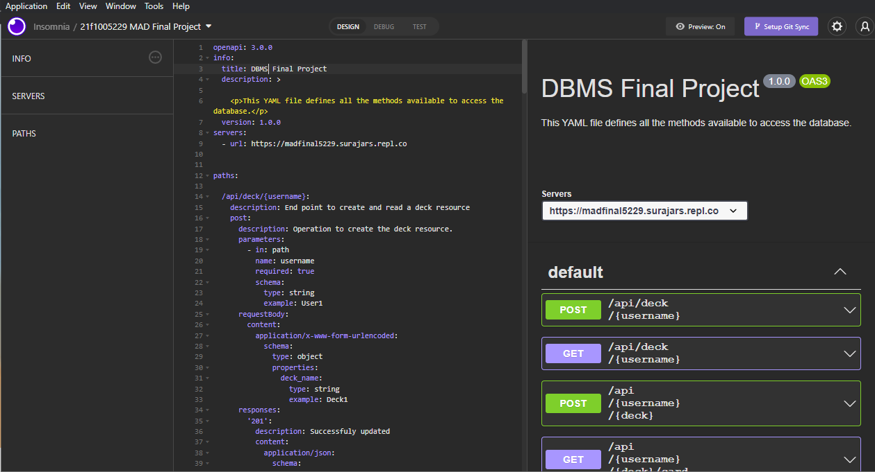
Insomnia

Slide 16
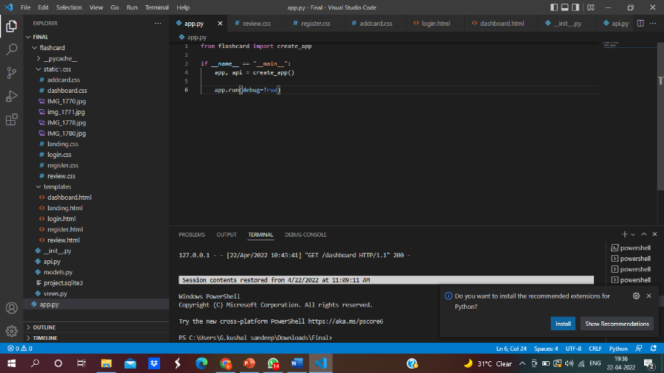
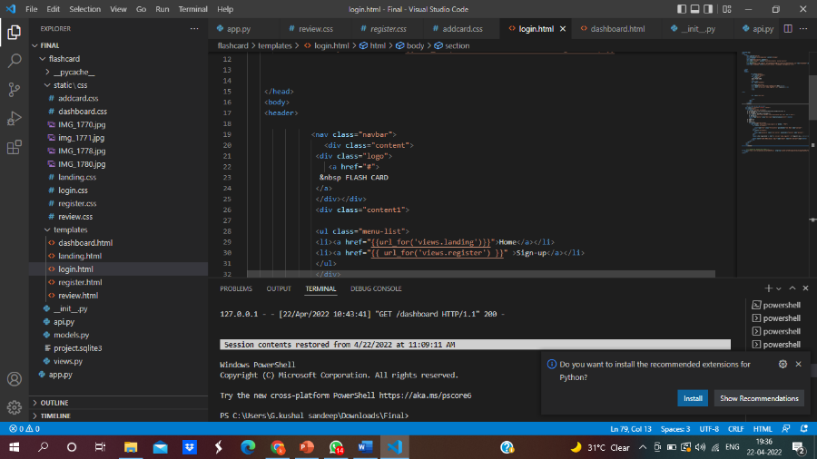
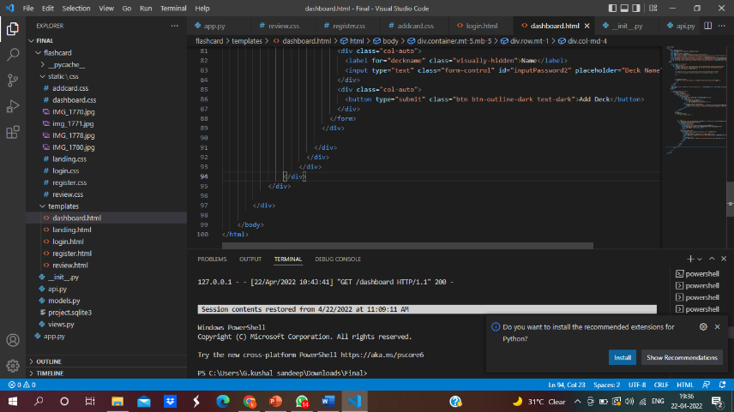
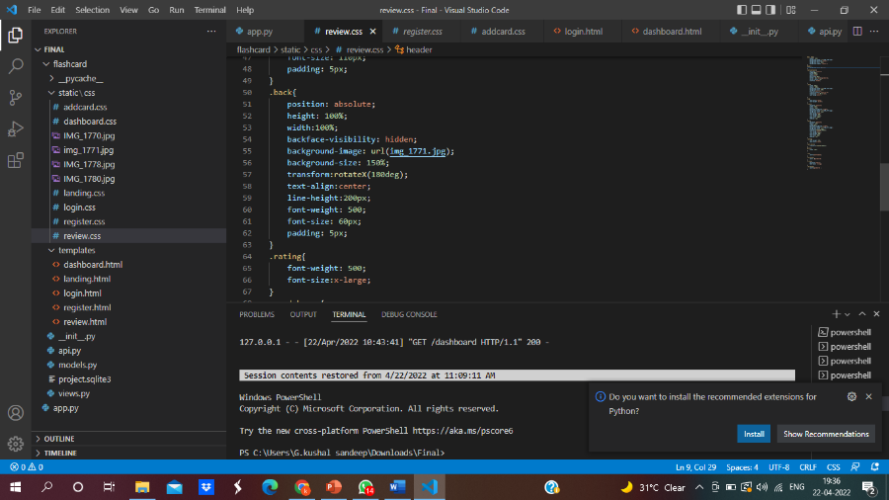
Codes

Slide 17
CONCLUSION
This app is a very useful study tool for both educational and professional purposes. Flash cards are incredible practical and useful resource and also they make the learning process more dynamic.

Slide 18
Thank you

